Slide 1
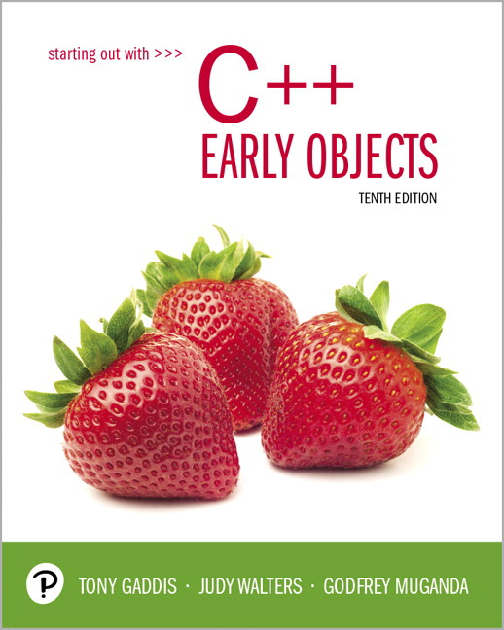
Starting Out with C++ Early Objects
Tenth Edition
Chapter 19
Stacks and Queues

Slide 2
Topics
19.1 Introduction to Stacks
19.2 Dynamic Stacks
19.3 The STL stack Container
19.4 Introduction to Queues
19.5 Dynamic Queues
19.6 The STL deque and queue Containers
19.7 Eliminating Recursion

Slide 3
18.1 Introduction to Stacks
Stack: a LIFO (last in, first out) data structure
Examples:
plates in a cafeteria serving area
return addresses for function calls

Slide 4
Stack Basics
Stack is usually implemented as a list, with additions and removals taking place at one end of the list
The active end of the list implementing the stack is the top of the stack
Stack types:
Static – fixed size, often implemented using an array
Dynamic – size varies as needed, often implemented using a linked list

Slide 5
Stack Operations and Functions
Operations:
push: add a value at the top of the stack
pop: remove a value from the top of the stack
Boolean function:
isEmpty: true if the stack currently contains no elements

Slide 6
Static Stack Implementation
Uses an array of a fixed size
Bottom of stack is at index 0. A variable called top tracks the current top of the stack
const int STACK_SIZE = 3;
char s[STACK_SIZE];
int top = 0;
top is where the next item will be added

Slide 7
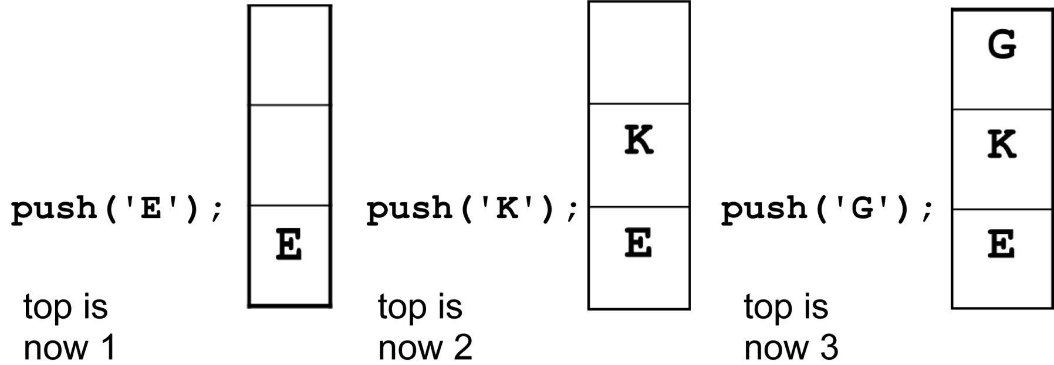
Array Implementation Example
This stack has max capacity 3, initially top = 0 and stack is empty.

Slide 8
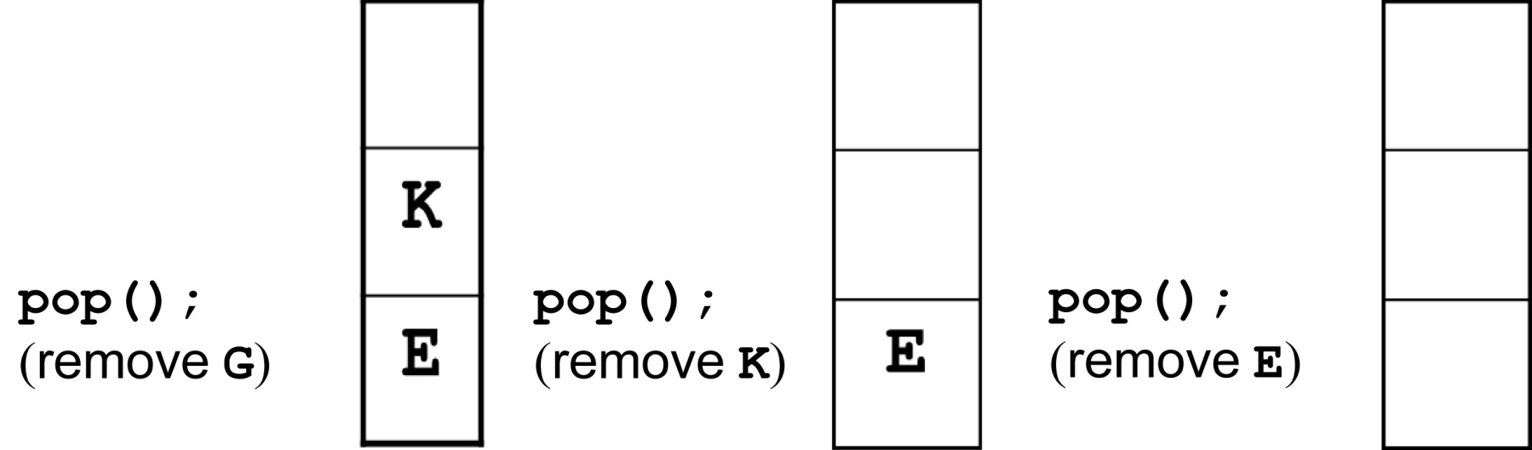
Stack Operations Example
After three pops, top is 0 and the stack is empty

Slide 9
Class Implementation Using an Array 1 of 5
class STACK
{
private:
unique_ptr<char []> s; // for the array
int capacity, top;
public:
void push(char x);
void pop(char &x);
bool isEmpty();
STACK(int capacity);
~STACK()
};
Notes:
See IntStack.h, IntStack.cpp, pr19-01.cpp

Slide 10
unique_ptr<> is one of the Smart pointer implementation provided by c++11 header to prevent memory leaks.
#include <memory>
A unique_ptr object wraps around a raw pointer and its responsible for its lifetime.
When this object is destructed then in its destructor it deletes the associated raw pointer.

Slide 11
unique_ptr<int> can hold a scalar of type int;
unique_ptr<int[]> can hold an array of int values with unknown number of elements.
A unique_ptr variable can constructed using make_unique
unique_ptr<int> p1(new int(4));
unique_ptr<int[]> p2(new int[n]());
The first line creates a unique_ptr to an integer value 4 and saves it in the p1 variable.
The second line creates a unique_ptr to an integer array of n elements and saves it to in the p2 variable.

Slide 12
Class Implementation Using an Array 2 of 5
Use exception classes as members of the STACK class to signal that an underflow or overflow condition has occurred:
class Overflow {};
class Underflow {};

Slide 13
Class Implementation Using an Array 3 of 5
To check if the stack is empty:
bool STACK::isEmpty()
{
return (top == 0);
}

Slide 14
Class Implementation Using an Array 4 of 5
To add an item to the stack
void STACK::push(char x)
{
if (top==capacity)
throw STACK::Overflow();
s[top] = x;
top++;
}

Slide 15
Class Implementation Using an Array 5 of 5
To remove an item from the stack
void STACK::pop(char &x)
{
if (isEmpty())
throw STACK::Underflow();
top--;
x = s[top];
}

Slide 16
Exceptions from Stack Operations
The preceding example uses exception classes to handle cases where an attempt is made to push onto a full stack (overflow) or to pop from an empty stack (underflow)
Programs that use push and pop operations should do so from within a try block.
catch block(s) should follow the try block to interpret what occurred and to inform the user.
Notes:
See IntStack.h, IntStack.cpp, and pr19-02.cpp

Slide 17
19.2 Dynamic Stacks
The storage for a stack can be implemented as a linked list
There is no need to indicate the initial capacity of the stack. It can grow and shrink as necessary.
It can't ever be full as long as memory is available, so there is no need to test for overflow.
Testing for underflow (empty stack) is still needed.

Slide 18
Dynamic Linked List Implementation
Define a class for a dynamic linked list
Within the class, define a private member class (LNode) for dynamic nodes in the list
Define a node pointer to the beginning of the linked list, which will serve as the top of the stack

Slide 19
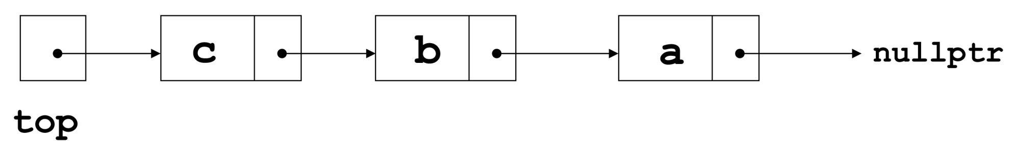
Linked List Implementation
A linked stack after three push operations:
push('a'); push('b'); push('c');

Slide 20
Operations on a Linked Stack 1 of 3
Check if stack is empty:
bool isEmpty()
{
return (top == nullptr);
}

Slide 21
Operations on a Linked Stack 2 of 3
Add a new item to the stack
void push(char x)
{
top = new LNode(x, top);
}

Slide 22
Operations on a Linked Stack 3 of 3
Remove an item from the stack
void pop(char &x)
{
if (isEmpty())
throw STACK::Underflow();
x = top->value;
LNode *oldTop = top;
top = top->next;
delete oldTop;
}
Notes:
See DynIntStack.h, DynIntStack.cpp, pr19-03.cpp

Slide 23
19.3 The STL stack Container
Stack template can be implemented using a vector, list, or a deque
Implements push, pop, and empty member functions
Implements other member functions:
size: number of elements on the stack
top: reference to element on top of the stack (must be used with pop to remove and retrieve top element)

Slide 24
Container Adapters
A class that provides a new interface to an existing class is a container adapter.
The purpose of a container adapter is to provide a specialized use of the existing class.
The STL stack container, using either a vector, a list, or a deque, is an example of a container adapter.

Slide 25
Defining an STL-based Stack
Defining a stack of char, named cstack, implemented using a vector:
stack< char, vector<char> > cstack;
Implemented using a list:
stack< char, list<char> > cstack;
Implemented using a deque (default):
stack< char > cstack;
Prior to C++ 11, spaces are required between consecutive > > symbols to distinguish from stream extraction
Notes:
See pr19-04.cpp

Slide 26
18.4 Introduction to Queues
Queue: a FIFO (first in, first out) data structure.
Examples:
people waiting to use an ATM
cars lined up to pay and exit a parking structure
Implementation:
static: fixed size, implemented as array
dynamic: variable size, implemented as linked list

Slide 27
Queue Locations and Operations
rear: position where elements are added
front: position from which elements are removed
enqueue: add an element to the rear of the queue
dequeue: remove an element from the front of a queue

Slide 28
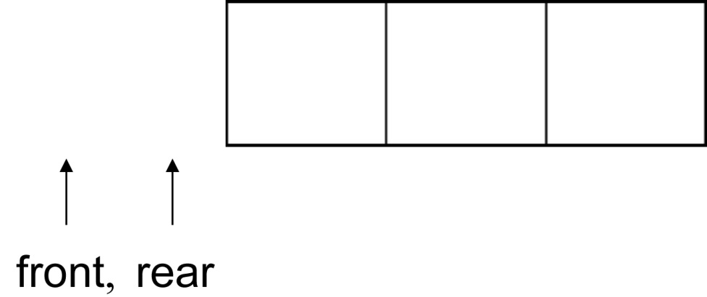
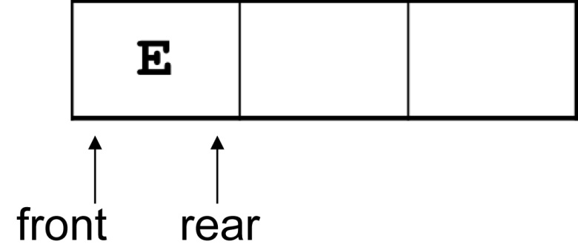
Array Implementation of Queue 1 of 3
An empty queue that can hold char values:
enqueue('E');

Slide 29
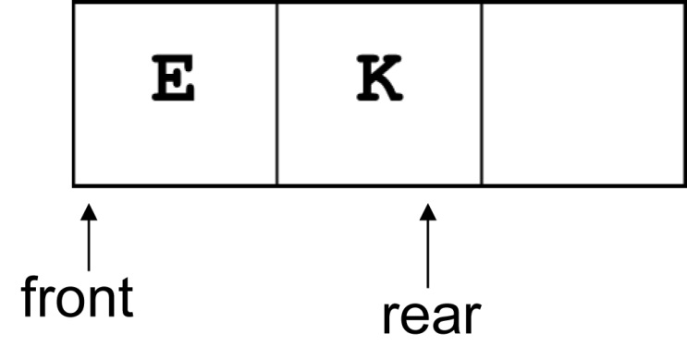
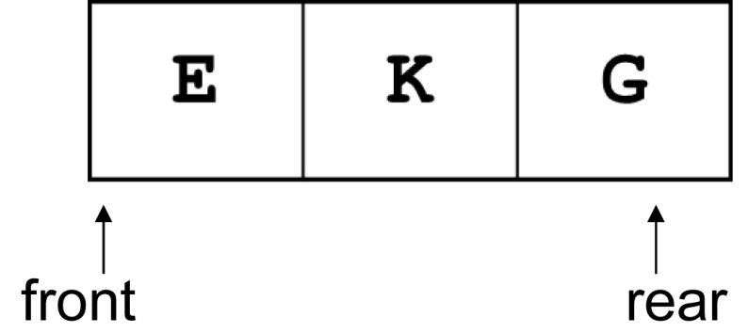
Array Implementation of Queue 2 of 3
enqueue('K');
enqueue('G');

Slide 30
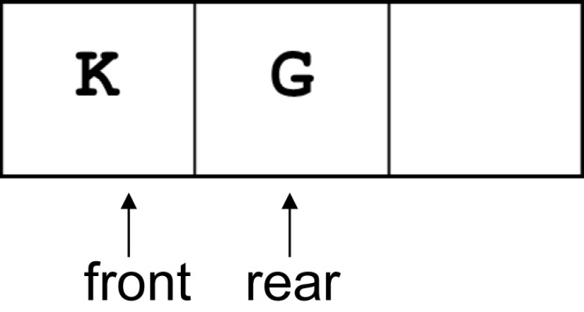
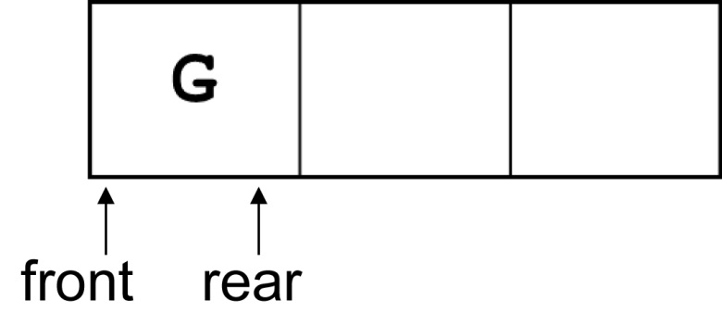
Array Implementation of Queue 3 of 3
dequeue(); // remove E
dequeue(); // remove K

Slide 31
Array Implementation Issues 1 of 2
In the preceding example, front never moves.
Whenever dequeue is called, all remaining queue entries move up one position. These moves takes time.
Alternate approach:
Use a ‘circular’ array: front and rear both move when items are added and removed. Both can ‘wrap around’ from the end of the array to the front if warranted.
Other solutions are possible

Slide 32
Array Implementation Issues 2 of 2
queue variables needed:
int qSize;
unique_ptr<int []> q;
int front = -1;
int rear = -1;
int number = 0; //how many in queue
These could be members of a queue class, and queue operations would be member functions

Slide 33
isEmpty Member Function
Check if queue is empty:
bool isEmpty()
{
return (number == 0);
}

Slide 34
isFull Member Function
Check if queue is full:
bool isFull()
{
return (number == qSize);
}

Slide 35
enqueue and dequeue 1 of 4
To enqueue, we need to add an item x to the rear of the queue
Queue convention says q[rear] is already occupied. Execute
if(!isFull)
{ rear = (rear + 1) % qSize;
// mod operator for wrap-around
q[rear] = x;
number ++;
}

Slide 36
enqueue and dequeue 2 of 4
To dequeue, we need to remove an item x from the front of the queue
Queue convention says q[front] has already been removed. Execute
if(!isEmpty)
{ front = (front + 1) % qSize;
x = q[front];
number--;
}

Slide 37
enqueue and dequeue 3 of 4
enqueue moves rear to the right as it fills positions in the array
dequeue moves front to the right as it empties positions in the array
When enqueue gets to the end, it wraps around to the beginning to use those positions that have been emptied
When dequeue gets to the end, it wraps around to the beginning use those positions that have been filled

Slide 38
enqueue and dequeue 4 of 4
Enqueue wraps around by executing
rear = (rear + 1) % qSize;
Dequeue wraps around by executing
front = (front + 1) % qSize;
Notes:
See IntQueue.h, IntQueue.cpp, and pr19-05.cpp

Slide 39
Exception Handling in Static Queues
As presented, the static queue class will encounter an error if an attempt is made to enqueue an element to a full queue, or to dequeue an element from an empty queue
A better design is to throw an underflow or an overflow exception and allow the programmer to determine how to proceed
Remember to throw exceptions from within a try block, and to follow the try block with a catch block

Slide 40
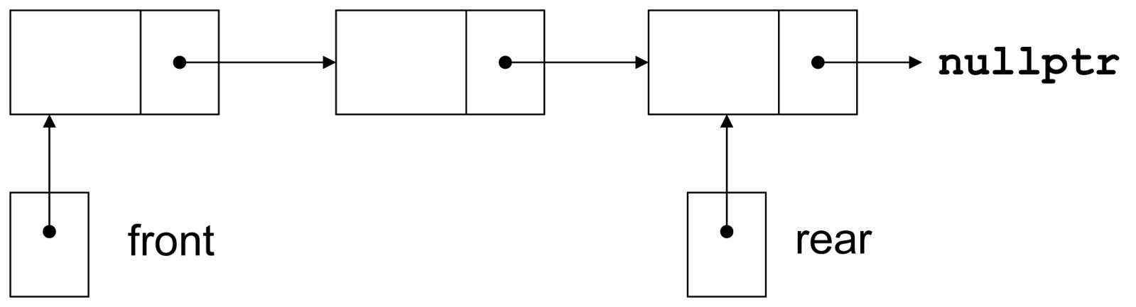
19.5 Dynamic Queues
Like a stack, a queue can be implemented using a linked list
This allows dynamic sizing and avoids the issue of wrapping indices

Slide 41
Dynamic Queue Implementation Data Structures
Define a class for the dynamic queue
Within the dynamic queue, define a private member class for a dynamic node in the queue
Define node pointers to the front and rear of the queue

Slide 42
Dynamic queue: isEmpty Member Function
To check if queue is empty:
bool isEmpty()
{
return (front == NULL);
}

Slide 43
enqueue Member Function Details
To add item at rear of queue
if (isEmpty())
{
front = new QNode(x);
rear = front;
}
else
{
rear->next = new QNode(x);
rear = rear->next;
}

Slide 44
dequeue Member Function
To remove item from front of queue
if (isEmpty())
{
// throw exception or print
// a message
} else {
x = front->value;
QNode *oldfront = front;
front = front->next;
delete oldfront;
}
Notes:
See DynIntQueue.h, DynIntQueue.cpp, and pr19-06.cpp

Slide 45
19.6 The STL deque and queue Containers
deque: a double-ended queue (DEC). Has member functions to enqueue (push_back) and dequeue (pop_front)
queue: container ADT that can be used to provide a queue based on a vector, list, or deque. Has member functions to enqueue (push) and dequeue (pop)

Slide 46
Defining a Queue
Defining a queue of char, named cQueue, based on a deque:
deque<char> cQueue;
Defining a queue with the default base container
queue<char> cQueue;
Defining a queue based on a list:
queue<char, list<char> > cQueue;
Prior to C++ 11, spaces are required between consecutive > > symbols to distinguish from stream extraction
Notes:
See pr19-07.cpp and pr19-08.cpp

Slide 47
19.7 Eliminating Recursion
Recursive solutions to problems are often elegant but inefficient
A solution that does not use recursion is more efficient for larger sizes of inputs
Eliminating the recursion: re-writing a recursive algorithm so that it uses other programming constructs (stacks, loops) rather than recursive calls
Notes:
See pr19.09.cpp

Slide 48

Copyright

